Slide 1
WELCOME TO OUR PRESENTATION
01

Slide 2
Ms. Sharun Akter Khushbu
Computer Science And Engineering Daffodil International University
02

Slide 3

TEAM
MEMBERS
Dip Sarkar
221-15-4639
Sadika Sharmin
221-15-5868
03

Slide 4

Travel Website
TABLE OF CONTENT
01
MOTIVE AND PROJECT OVERVIEW
02
SNAPSHOT OF PROJECT INTERFACE
03
TERMS THAT WE USED
04
FUTURE SCOPE OF THIS PROJECT
05
PROS AND CONS
04

Slide 5

MOTIVE
OF THIS PROJECT
05

Slide 6
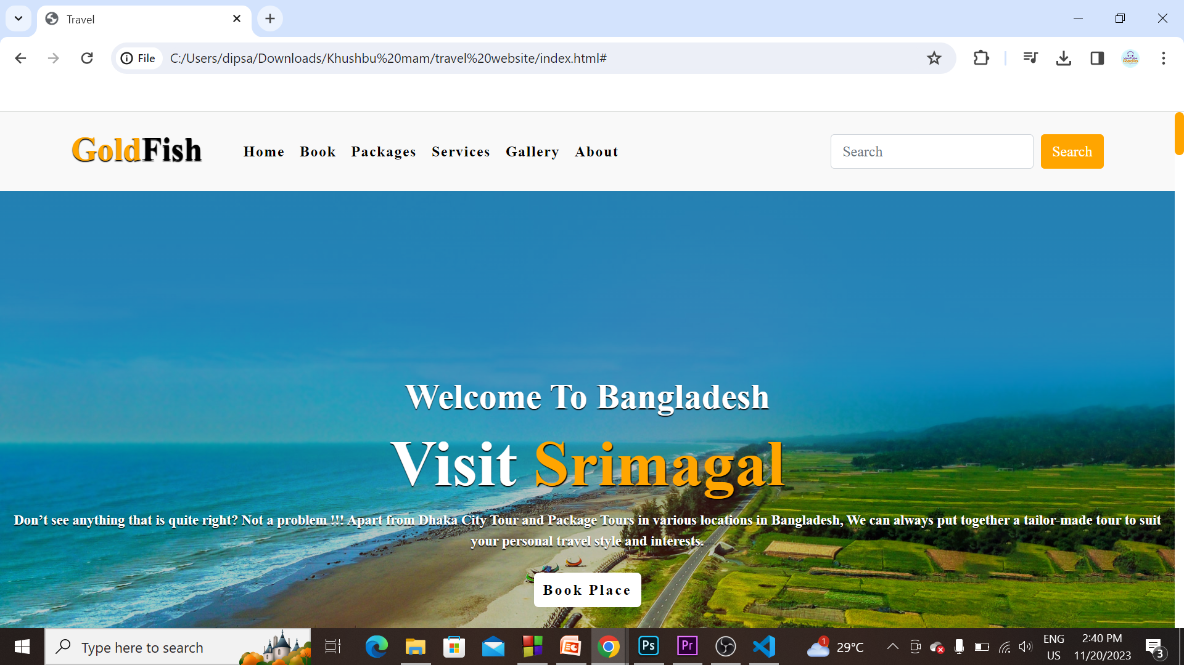
PROJECT
INTERFACE
06

Slide 7
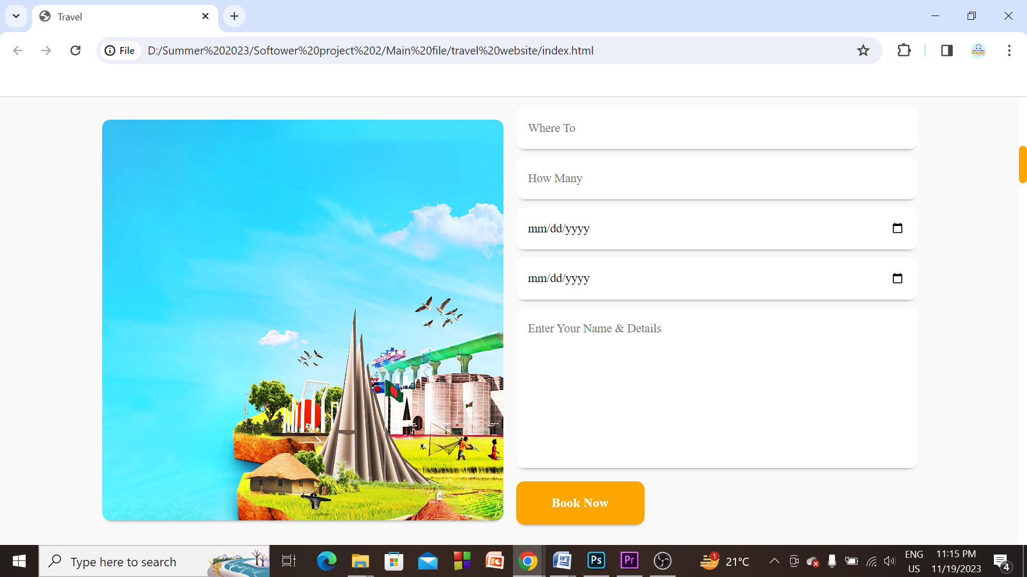
PROJECT
INTERFACE
07

Slide 8
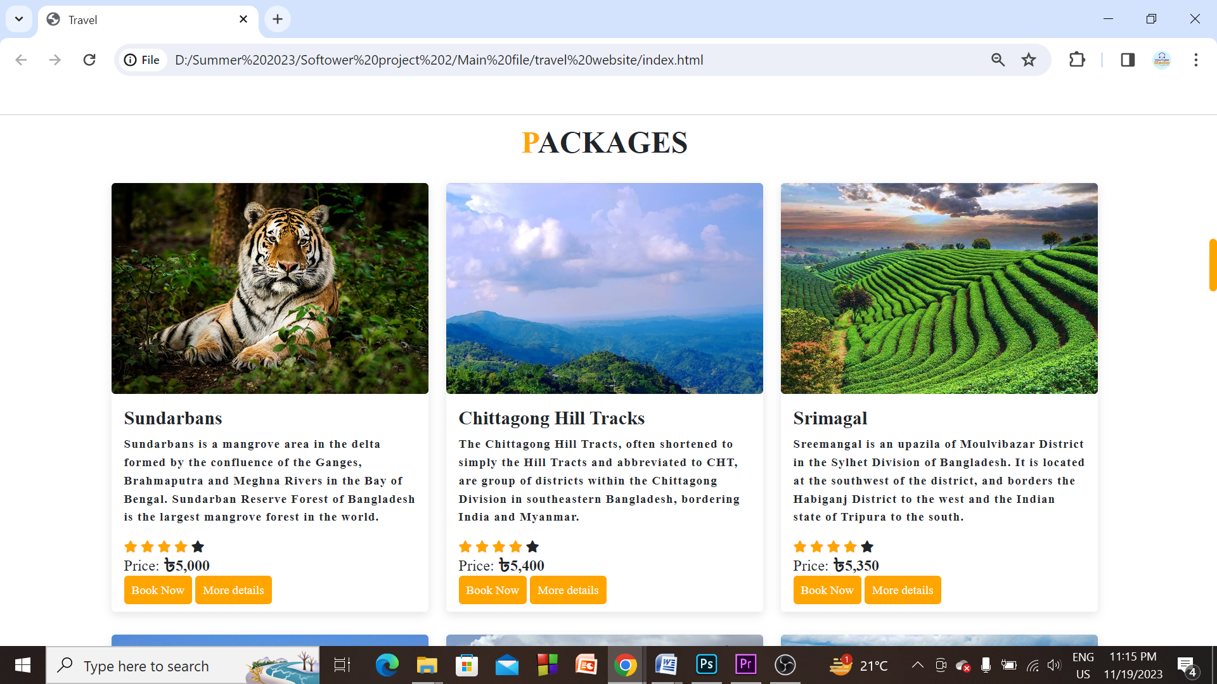
PROJECT
INTERFACE
08

Slide 9
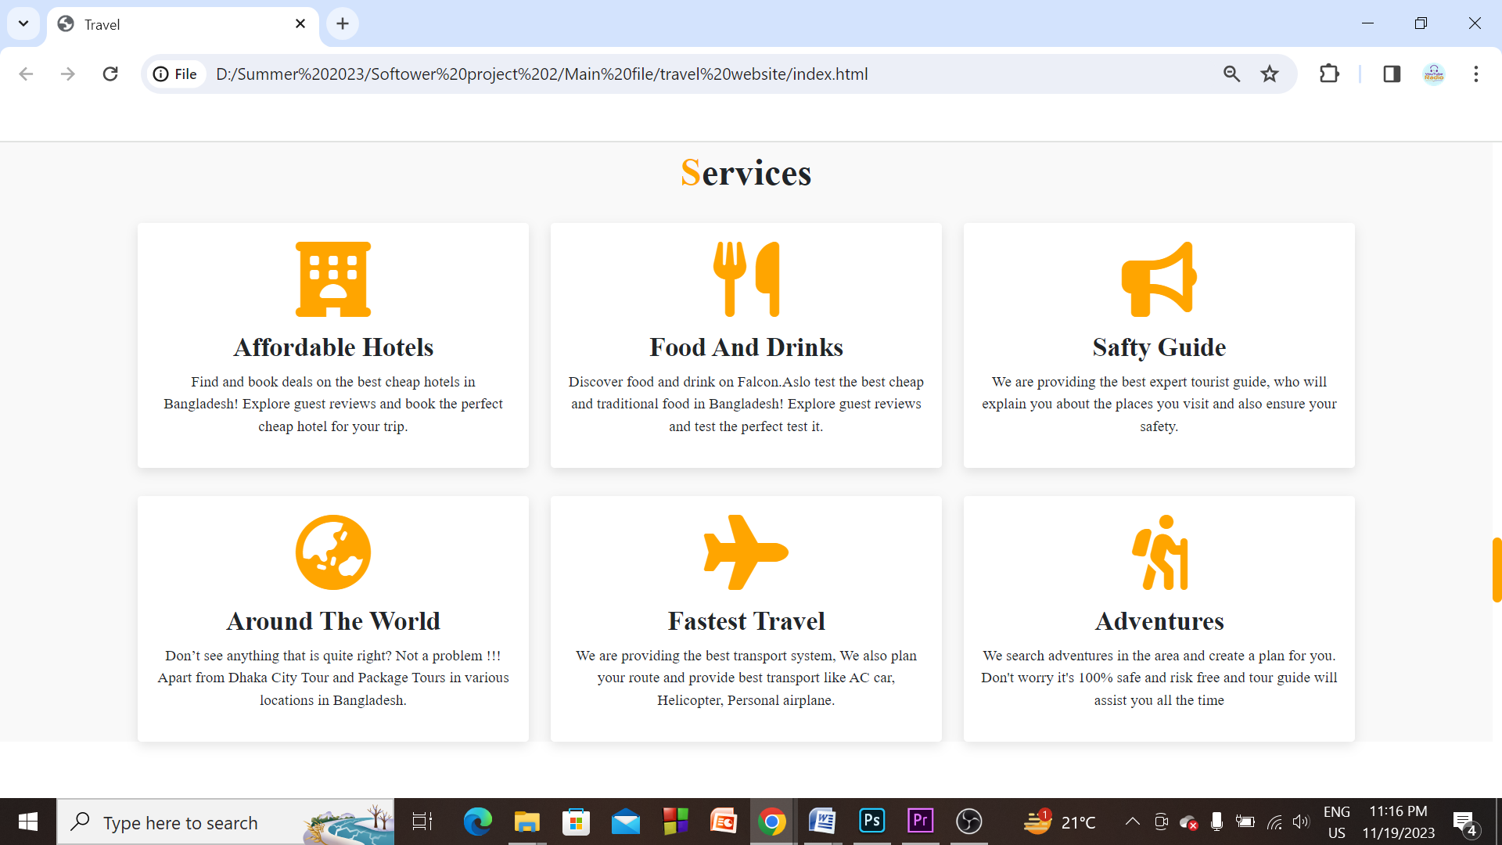
PROJECT
INTERFACE
09

Slide 10
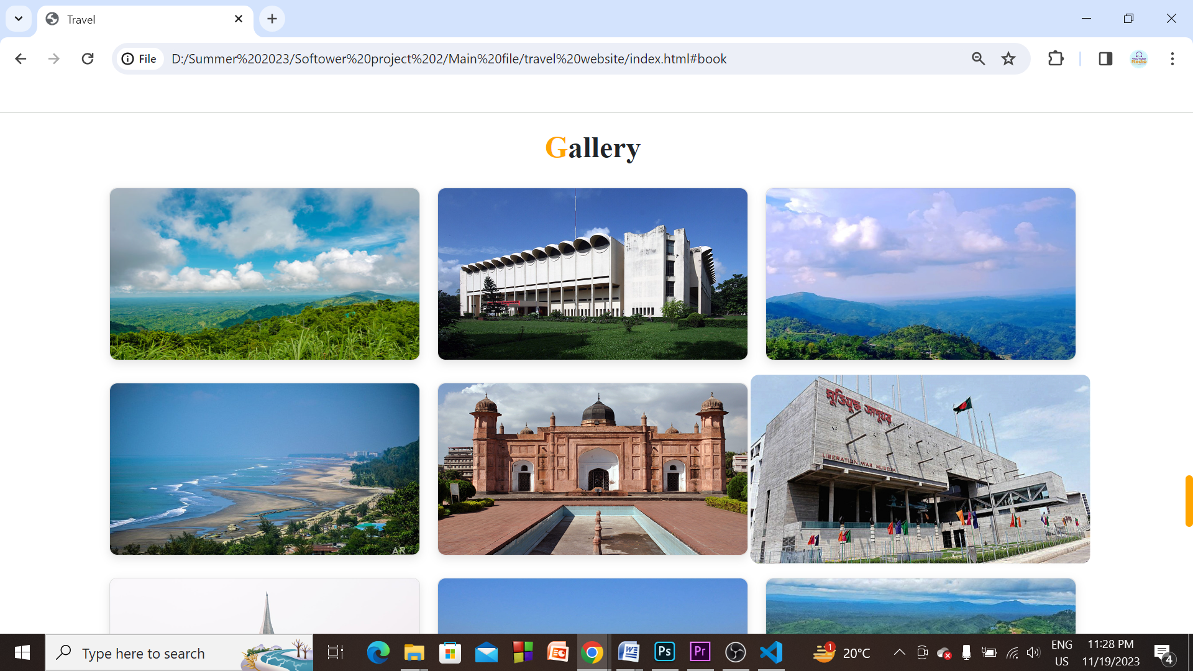
PROJECT
INTERFACE
10

Slide 11
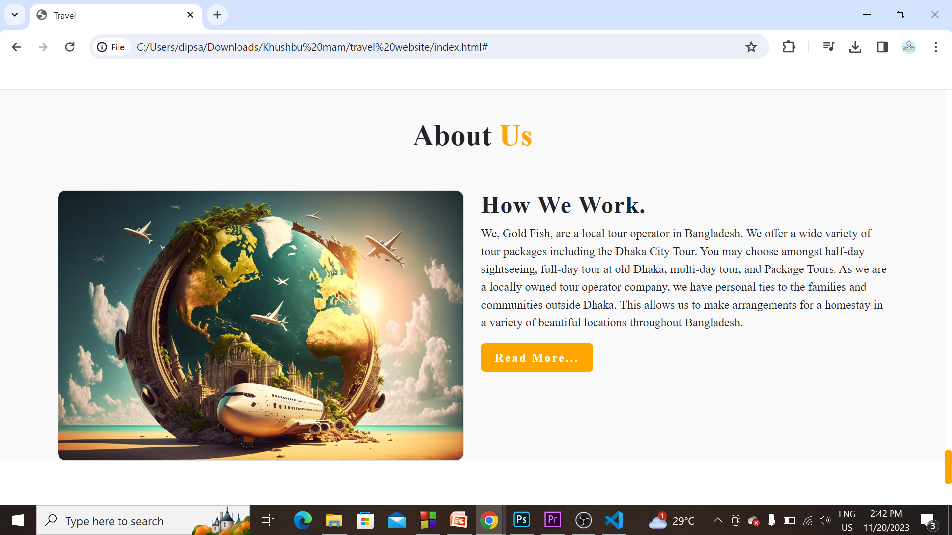
PROJECT
INTERFACE
11

Slide 12
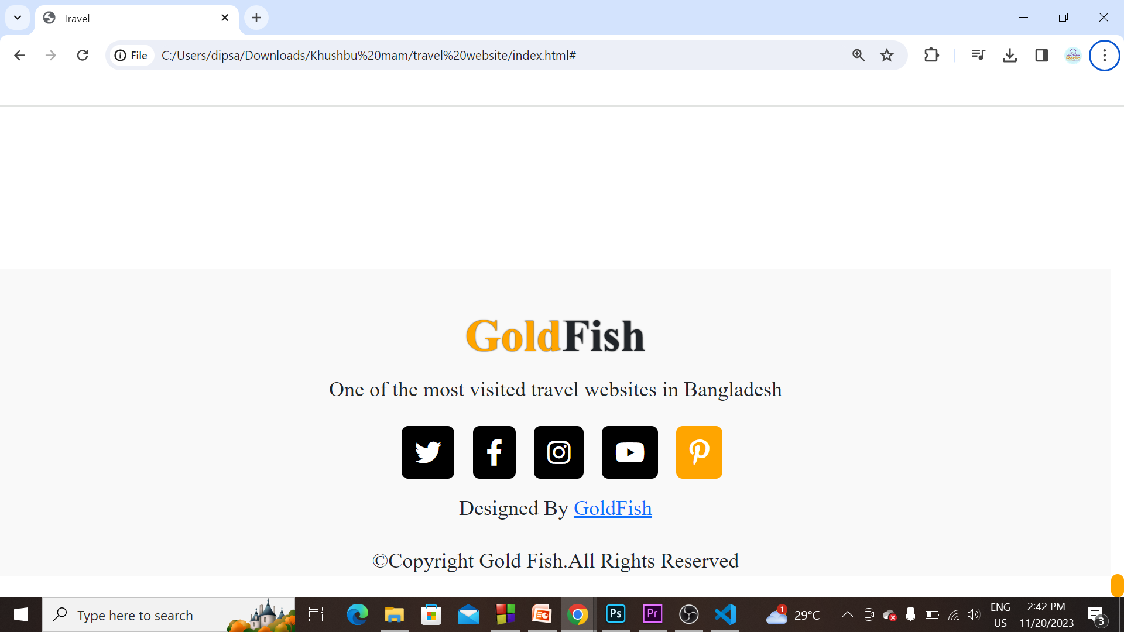
PROJECT
INTERFACE
12

Slide 13
We used HTML,CSS, BOOTSTRAP to complete this project.
TERMS THAT
WE USED
HTML: :
HTML is the standard markup language for Web pages
CSS:
CSS is the language we use to style a Web page.
BOOTSTRAP:
Bootstrap is the most popular CSS Framework for developing responsive and mobile-first websites.
13

Slide 14
User Interface improvement
Real-Time Updates
Mobile Application Development
Use AI and Machine Learning
Data Analytics
Multi-Format Support
Enhanced Reporting
Cloud Integration
Integration with Other Systems
Community Engagement
Localization and Globalization
FUTURE SCOPE
14

Slide 15
PROS
OF THIS PROJECT
Increased Brand Awareness
Lower Cost of Operations
Access to a Wider Customer Base
Ability to Leverage Their Marketing Budgets
Time Consuming
Simplified Bookings Process
Lack of Direct Client Relationship
Brand Dilution and Loss of Customer Ownership
Commission Fees
Limited Customization and Branding
Dependency on Third-Party Platforms
5. Miscommunication
CONS
OF THIS PROJECT
15

Slide 16
THANKS
16

